Slide 1
PSY 301 Psychological Statistics
Instructor: Jibo He, PhD
Lab TA: Kevin Morales

Slide 2
Introduce yourself ☺
Name, specific interest in psychology
Tell me your understanding about statistics
Go through syllabus

Slide 3
Useful resources
Khan Academy
http://www.khanacademy.org/
Saylor foundation
http://www.saylor.org/majors/mathematics/

Slide 4
WAYS TO EARN POINTS IN THIS COURSE
The total score for this course is 750, which is composed of:
Exams: 550
Lab points: 50
In-class activities: 30
Quizzes (and Homework): 100
Extra points opportunities, cheat sheet: 20

Slide 5
Class Introduction
Policy
Each attendance will be given one credit. The faculty reserve the rights and possibility to fail a student with at least four no shows.
No cell phone use during lecture.
Students are encouraged to ask questions and answer questions.

Slide 6
Class Introduction
Lectures:
Mixture of slides and handwriting on the blackboard
Notations, notations, notations!!
Lab Section:
Quizzes;

Slide 7
Chapter Outline
Introduction - Statistics Defined
Populations and Samples
Research Methods - Major Types
Scales of Measurement
Classification of Variables
SPSS Computer Software - Data Entry by Spreadsheet

Slide 8
“Why do we have to take Statistics?”
Psychologists use Statistics to describe their observations objectively.
Psychology is the science of behavior.
Statistics is a tool used by Psychologists and it is the most important tool.
(Research Methods =Statistics, Part II)

Slide 9
Definition of Statistics…
C
Collecting …
Data
O
Organizing …
D
Displaying …
I
Interpreting …
A
Analyzing …

Slide 10
Introduction to Statistics
Statistics - mathematical procedures used to summarize, analyze, and interpret observations
Data - numbers assigned to observations according to rules, called “scores” or “raw scores”
Allows quantitative analysis
Two branches:
Descriptive - summarize and organize scores
Inferential - allows sample results to be generalized to representative populations
Interpret meaning

Slide 11
Application to Research

Slide 12
What is Data?
Variable:
Anything that can vary; it is anything that can take on a different quality or quantity
Level of income, level of education, voter preference, aggression level, test score, students’ age, crime rate,…
Data:
The information about different variables is referred to as data.
When the data relative to some specific variables are assembled, we refer to the collection or bundle of information as data set. The individual pieces of information are referred to as data points, but taken together, the data points combine to form a data set.
Notes:
Collect 100 patient information from a hospital.

Slide 13
A motivating example
Is the new teaching method more effective than the usual teaching method?
Usual method: Stand here and lecture
New method: New media
In an experiment, you manipulate the independent variable (IV) and measure the dependent variable (DV)
IV is method of teaching (new vs. usual)
DV is test score
Do students taught with new method score higher on the test than students taught normally?

Slide 14
Independent vs. dependent variables
In psychological experiment, we manipulate independent variables, and see how those IVs affect the values of DVs.
We normally attempt to explain variability of the phenomena of interest (the dependent variables) by attributing it to its presumed causes (the independent variables).
Notes:
In statistics, we dichotomize the concept of a variable in terms of independent and dependent variables.

Slide 15
Two branches of statistics
Descriptive Statistics
Describes a given set of data you have.
Inferential Statistics
Given the data you have about these people (sample),
does this say anything about other people (population)?

Slide 16
Two branches of statistics
Descriptive Statistics
Procedures typically used to quantify measured behaviors
Allows for clear presentation of data summary (i.e. tables, graphs or single values)
Inferential Statistics
Data typically drawn from a portion of the overall group of interest
Allows researchers to make inferences about parameters in a population based on a sample of data

Slide 17
The keys to doing well in this course
Take notes
Draw pictures, visualize the numbers
Do the practice problems
Ask questions

Slide 18
Lecture 1 “The What and How of Statistics”

Slide 19
Concepts
Population
All possible cases that meet certain criteria, or the total collection of cases you are interested in (sometimes refer to as “universe”).
E.g. GPA of freshman in community colleges
It can be of any size
It is always hard to observe the entire population
Population is apt to constant change
You have no access to the entire population due to the time and cost limit.
Notes:
Students drop out

Slide 20
Concepts
Sample
Subset or proportion of entire population drawn by:
Random sample (sample is representative of the population)
Representative sample: sample that mirrors the population in important respects.
Notes:
Imagine a population that has a male/female split of 60% and 40%. If a sample of the population is representative, you would expect it to have a male/female split very close to 60%, 40%. You might not get exact the same split, but it should be fairly close. We will talk more about sampling later.

Slide 21
Concepts
Variable: is a property of an object or event that can take on different values
Discrete vs. Continuous
Gender (take on limited number of values)
Age
Data
Categorical data
Quantitative data (Continuous data)
Notes:
Having dealt with the selection of subjects and random assignment, it is time to consider how we treat each group and how we will characterize the data.
For instance, if we are interested to study the ability of subjects to deal with stress and maintain high self-esteem under different kind of treatments, and because the response to stress is a function of many variables, a critical aspect of designing a study involves selecting the variables to be studied.
Closely related to the distinction between discrete and continuous variables is the distinction between quantitative and categorical data. By quantitative data, we mean the result of any sort of measurement—for example, grades on a test, people’s weights, scores on a scale of personality, so on.
Categorical data are illustrated with such statements as “there are 34 males and 26 females in the study”
We will come back to these concepts later when we talk about “probability”, by then I will introduce notions.

Slide 22
Research Methods
Science - systematic study of relationships
Applied using the research method
Three common research methods
Experimental Method
Quasi-Experimental Method
Correlational Method

Slide 23
Research Methods
Experimental Design
Cause-effect analyses
High level of control to isolate cause and effect
Must satisfy requirements to be an experiment
Manipulation
Randomization
Comparison/control

Slide 24
Research Methods
Meeting Experimental Criteria
Random Assignment renders groups equivalent (Requirement 2)
Must manipulate levels of an Independent Variable (Requirement 1)
Independent Variable (IV) - manipulated; the proposed cause
Example: New or Traditional Teaching Method

Slide 25
Research Methods
Experimental Criteria Continued
At least two groups observed (Requirement 3)
Dependent Variable (DV) – what is measured; proposed effect
Operational Definition – how will DV be measured
Experimental Group - exposed to IV
New Teaching Method
Control Group - not exposed to IV
Traditional Teaching Method
Research Question: Does the IV (Type of Teaching Method) cause a difference in the DV (Reading Achievement Scores)?

Slide 26
Summary
(continued next page)

Slide 27
Summary
The basic structure of an experiment that meets each basic requirement for demonstrating cause and effect using an example of a study in which
a sample of students was selected at random from a population of all undergraduates to test the effects of a distraction on exam performance.
To qualify as an experiment,
the researcher created each level of distraction (manipulation),
students were randomly assigned to experience a low- or high-distraction condition while taking an exam (randomization), and
(3) a comparison group was included where distraction was minimal or
absent (comparison/control).

Slide 28
Research Methods
Quasi-Experiment - includes
a non-manipulated IV (classification variable);
lack of random assignment to groups; and/or
lack of control (comparison) group.
Example: Do boys and girls (IV) differ in number of aggressive behaviors (DV)?
Example: Are there differences between 20-year-old and 40-year-olds (IV) in reaction time (DV)?

Slide 29
Research Methods
Correlational - analyses for prediction
Quantifies the strength and direction of a relationship between two (or more) variables (X and Y)
Variables measured as they naturally occur
Lack of random assignment
Lacks control to determine cause-effect
Example: What is the relationship between SAT scores (X) and freshman college GPA (Y)?

Slide 30
Scales (Levels) of Measurement
Every variable is measured at a certain level, and some levels are, in a sense, more sophisticated than others.
Example: test scores
Ranks
Actual score
Notes:
Closely related to variables is the concept of levels of measurement

Slide 31
Scales (Levels) of Measurement
Nominal
Categorical
Values correspond to different categories
Categories are not ordered, such as religious status
The categories have to be mutually exclusive and collectively exhaustive.
Notes:
Let us consider each level of measurement, from the simplest to the most complex.
You have to have a category for every observation

Slide 32
Scales (Levels) of Measurement
Ordinal
Categorical
Values can be ordered along a continuum
Examples: ranks
Distance between categories not equal
For instance, you give people the following response options—less than high school graduate, high school graduate, some college, college graduate.
Notes:
You will know….have less education than those who answered….

Slide 33
Scales (Levels) of Measurement
Interval
Continuous – Properties of an ordinal scale plus
Distance between levels are equally spaced—equal interval
Temperature (above or below zero, but zero is rather artificial)
Time to get up in the morning
IQ
No true absolute zero point
Notes:
A classification that was proposed in order
to describe the nature of information
contained within numbers assigned to the
data and, therefore, within the variable.

Slide 34
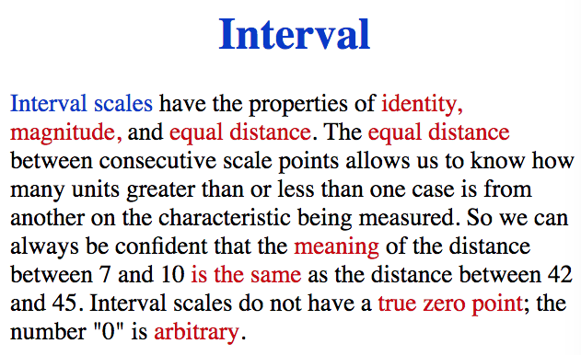
Level of Measurement
Notes:
http://www.psychology.emory.edu/clinical/bliwise/Tutorials/SOM/smmod/scalemea/print2.htm

Slide 35
Level of Measurement
Interval Scale:
Example: Melissa has an SAT score of 1205, while Kevin has an SAT score of 1090. Melissa scored 115 points more than Kevin.
You can’t score ZERO on the SATs. If you sign your name, you get 200 points per section. Therefore, zero is arbitrary.

Slide 36
Level of Measurement
Interval Scale:
Many of our standardized tests in psychology use interval scales. An IQ (Intelligence Quotient) score from a standardized test of intelligences is a good example of an interval scale score.

Slide 37
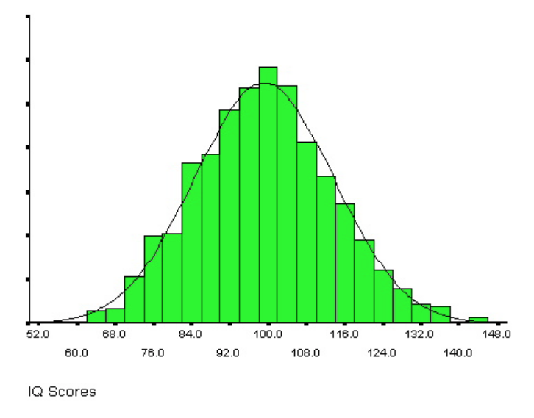
Level of Measurement
Interval Scale:
An IQ (Intelligence Quotient) score from a standardized test of intelligences is a good example of an interval scale score.

Slide 38
Scales (Levels) of Measurement
Ratio
Continuous – Properties of an interval scale plus
Can compare ratios of scores at any location
Has a legitimate zero point
Examples: weight, height(zero is the beginning point of the ruler, yardstick, or tape measure), days absent from work

Slide 39
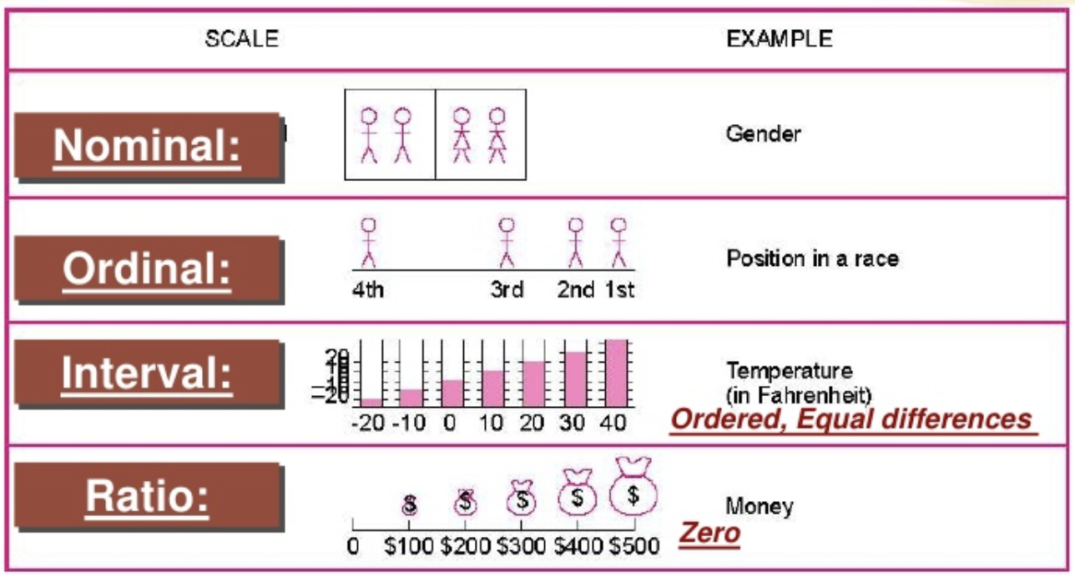
Level of Measurement

Slide 40
Summary of Knowledge
Level of measurement
Incremental Progress | Measure Property | Mathematical Operators | Advanced Operations | Central Tendency
Nominal | Classification, Membership | =, != | Grouping | Mode
Ordinal | Comparison, Level | >, < | Sorting | Median
Interval | Difference, Affinity | +, - | Yardstick | Mean,Deviation
Ratio | Magnitude, Amount | *, / | Ratio | Geometric Mean,Coeff. of Variation
Source: https://en.wikipedia.org/wiki/Level_of_measurement

Slide 41
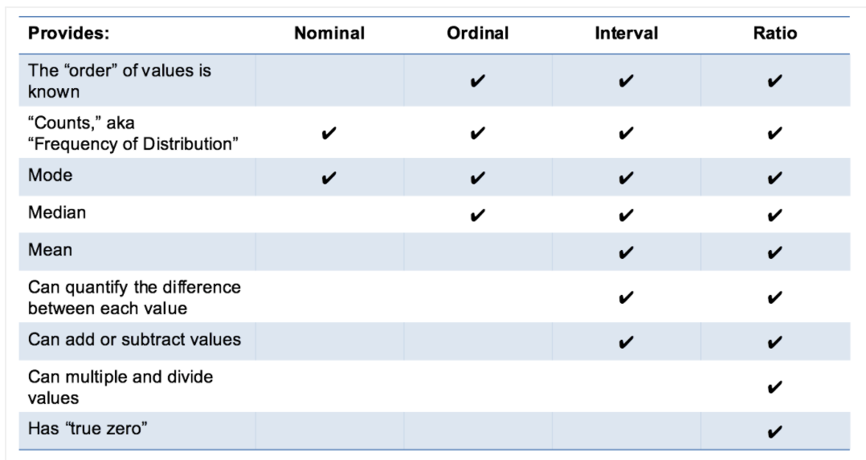
Summary of Knowledge
Level of measurement
Notes:
http://www.mymarketresearchmethods.com/types-of-data-nominal-ordinal-interval-ratio/

Slide 42
Summation notation
Population
Sample
Variable
Independent variable
Dependent variable
Data
Nominal
Ordinal
Interval
Ratio
Descriptive vs. Inferential Statistics

